Slide 1

By Manvendra Pratap Singh
Business Analyst Career Program - Capstone Project

Slide 2

Agenda
Data Exploration
Statistical Analysis using Excel
Graphical Analysis using Excel
Insert the given data into the SQL server
Import the Data from the SQL Database into PowerBI
Interactive Dashboard by using visualization tools
Conclusion and Inferences
Endnotes

Slide 3
Data Exploration
Represents sale of the premium bicycle brands across various countries and different segments of the market.
Gives us various insights into the sales data like profit, discount, etc.
Can be used to analyze the sales over time
Data tells about which product has more market share.
Will help in making needful business decisions and increase sales

Slide 4
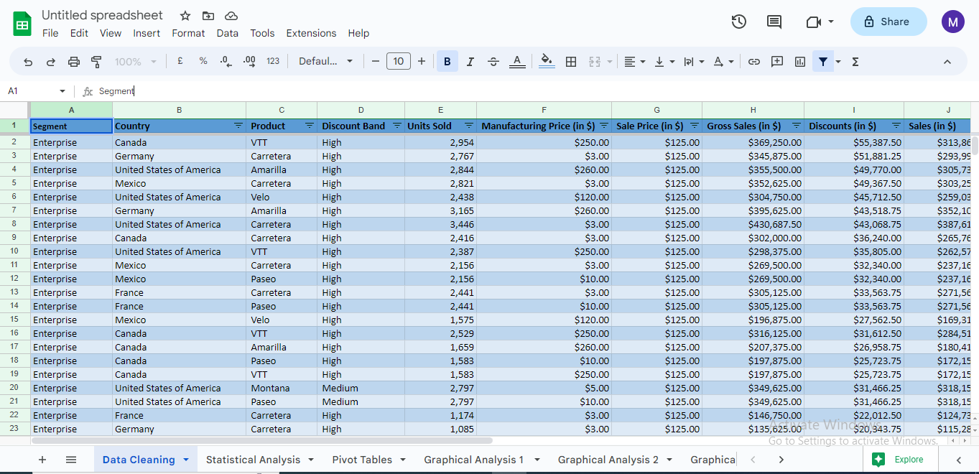
Data Exploration (continued)

Slide 5
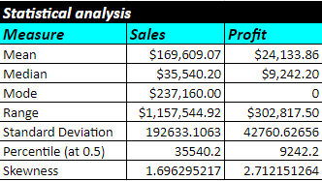
Statistical Analysis using Excel

Slide 6
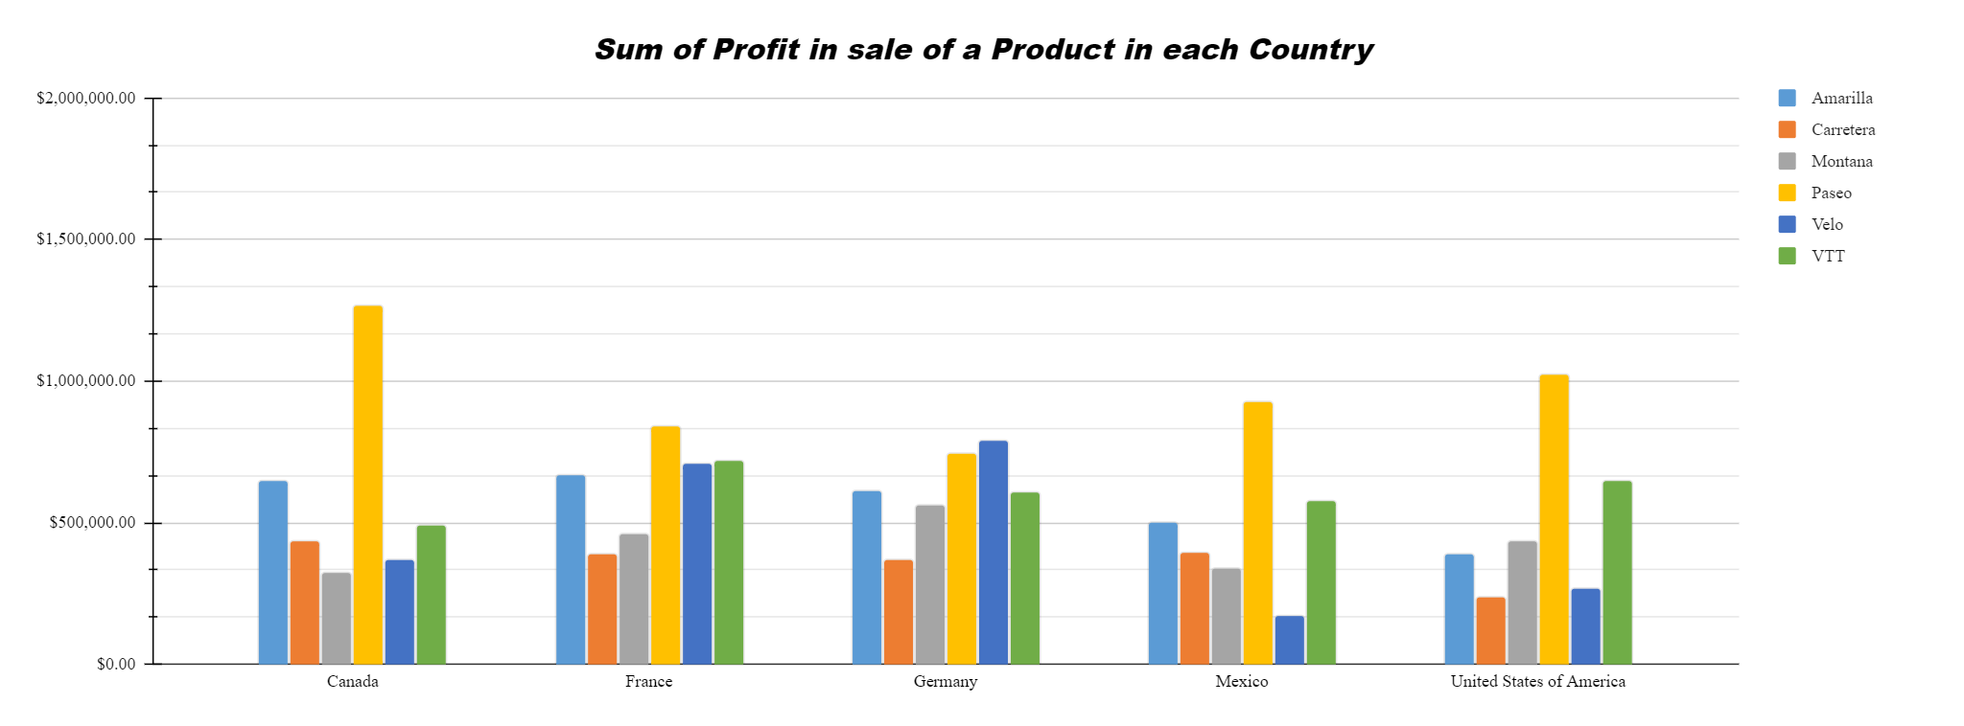
Graphical Analysis using Excel
The graph below shows the sum of profit for each product in each country where it was sold.
Clearly, Paseo has the highest sale in Canada and Velo has the lowest in Mexico.

Slide 7
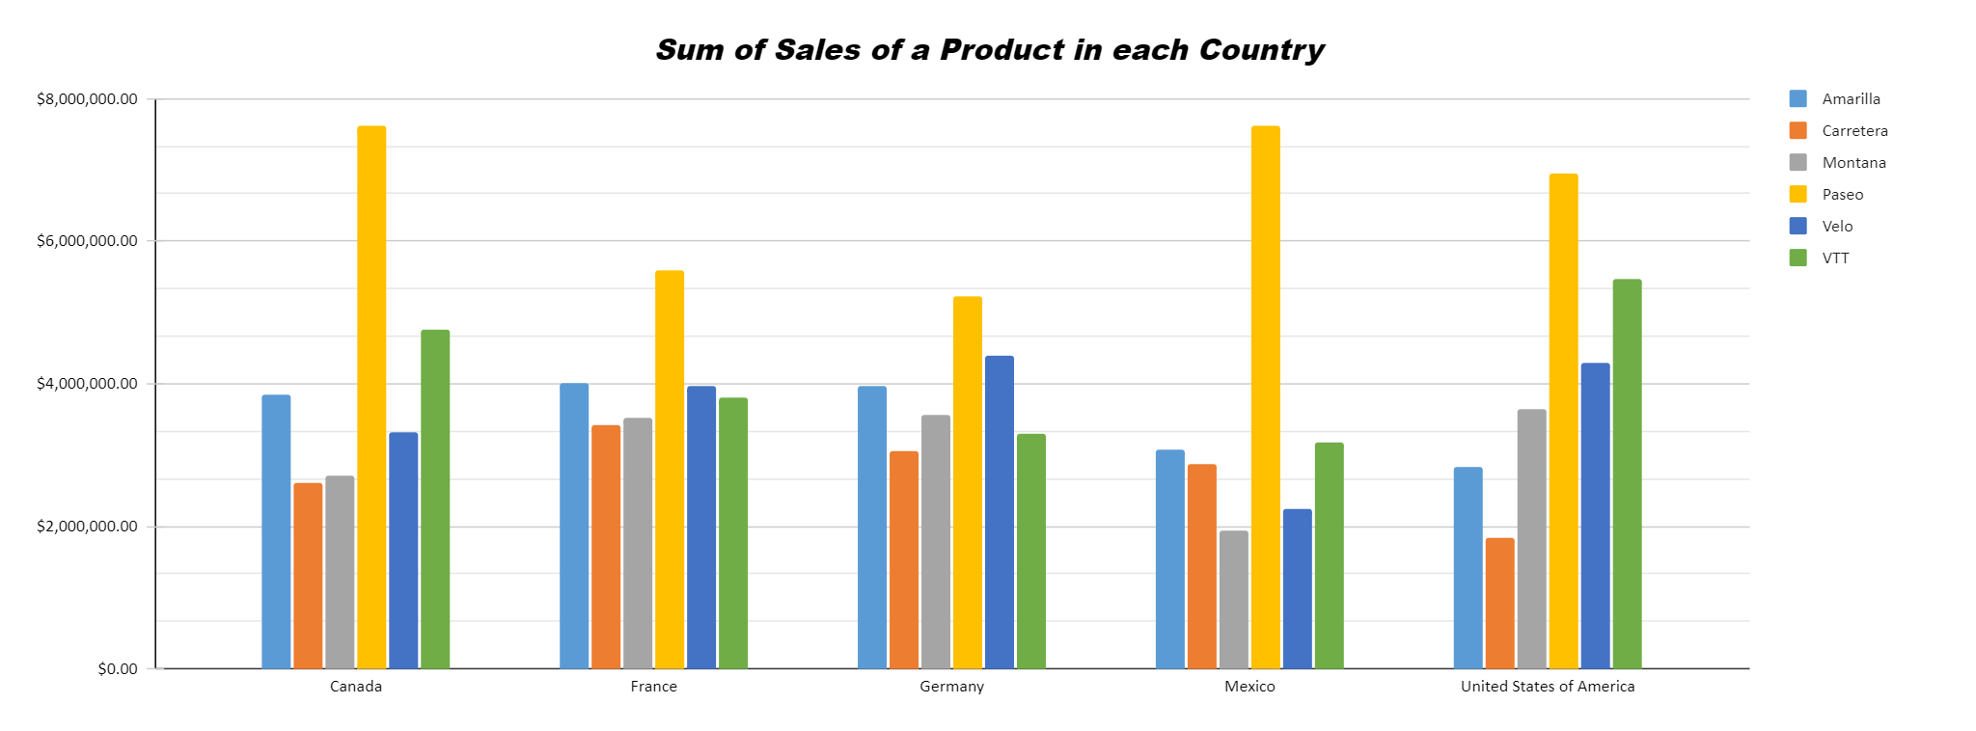
Graphical Analysis using Excel
The graph below shows the sum of sales for each product in each country where it was sold.
As per the graph, Paseo has the highest sale in Mexico and Carretera has the lowest in United States of America.

Slide 8
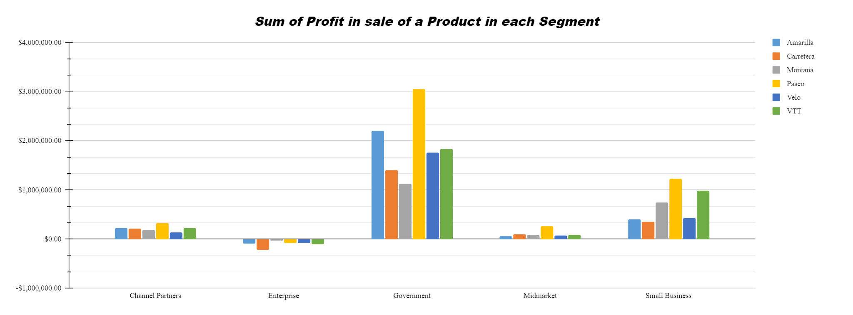
Graphical Analysis using Excel
The graph below shows the sum of profit for each product and the market segment where it was sold.
Clearly, Paseo has the highest profit in the Government segment while Carretera has the highest loss the Enterprise segment.

Slide 9
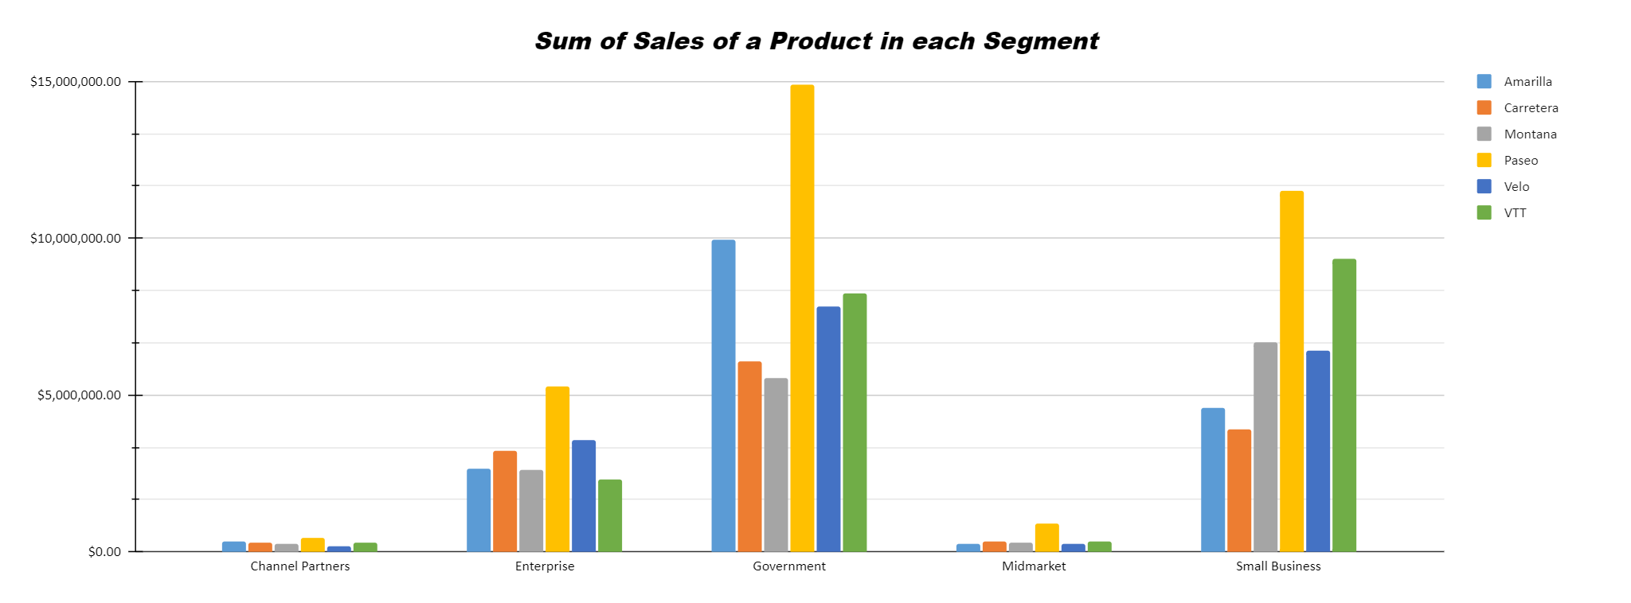
Graphical Analysis using Excel
The graph below shows the sum of sales for each product in each country where it was sold.
Clearly, Paseo has the highest sale in Government segment while Velo has the lowest in Channel Partners segment.

Slide 10
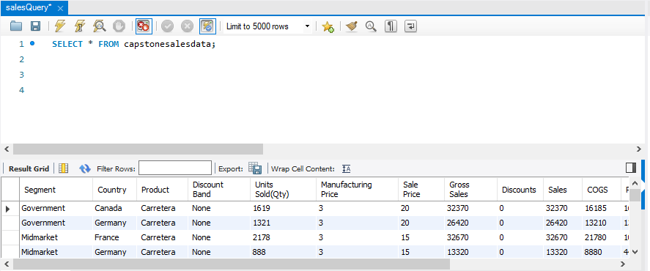
Insert the given data into the SQL server
The data has been successfully inserted as shown in the below screenshot with table name capstonesalesdata.

Slide 11
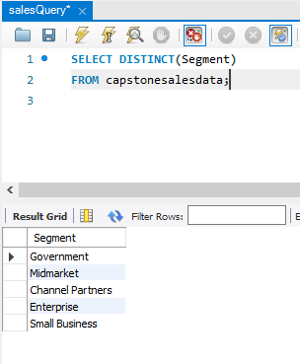
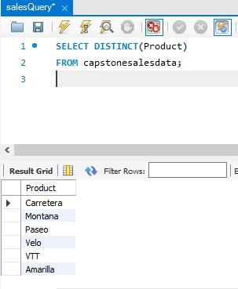
Insert the given data into the SQL server (continued)

Slide 12
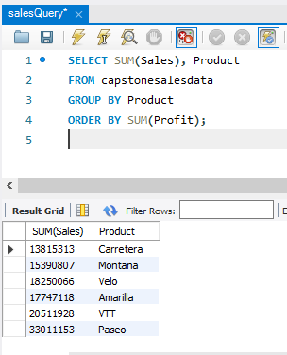
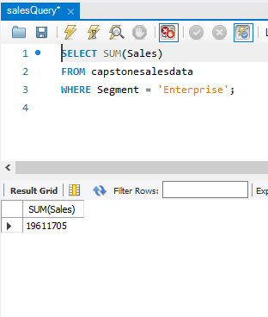
Insert the given data into the SQL server (continued)

Slide 13
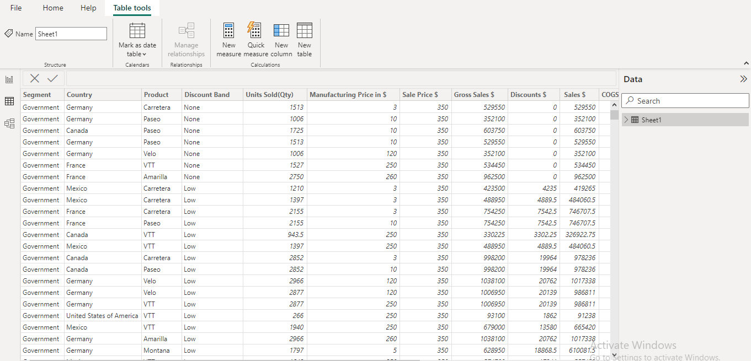
Import the Data from the SQL Database into PowerBI
Insert the relevant screenshots verifying that the data is successfully inserted into PowerBI and do the required data cleaning or creation of measured for data analysis

Slide 14
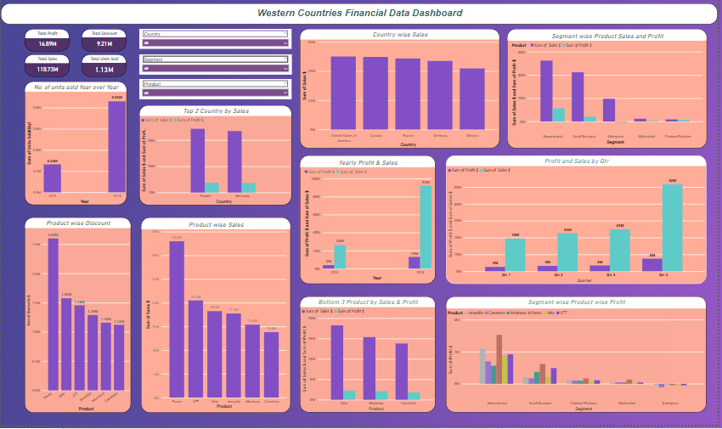
Interactive Dashboard by using visualization tools

Slide 15
Conclusion and Inferences
Inferences :
The financial data suggests that the premium bicycle brands are performing better in Western countries than their European counterparts.
Maybe poor sales and profitability performance attribute to a combination of factors, such as poor marketing strategies and lack of brand awareness, in the European countries.
To improve its performance, the brand may need to invest in better marketing and advertising strategies, develop a more competitive pricing strategy, and maybe provide new features in the products.
Conclusion :
Analyzing financial data of western countries provides valuable insights for business growth. By understanding over all sales trend , market share , consumer behavior we get to know that Paseo is the most profitable product for the organization. Organization should focus more on adding new features in other brands.

Slide 16
Endnotes
Reference Links:-
Google sheets link:
https://docs.google.com/spreadsheets/d/1I1z-5svxl-2M4U6o1QG5RBqFyjAHQoVT-X2flx6zYNM/edit?usp=sharing
Power BI link:
https://drive.google.com/file/d/1XpbRA_b03BfTMsRRlIQ5A1S4CHq4DsYb/view?usp=sharing

